Slide 1
OBJECTIVES:
What is HTTP?
Basic Features of HTTP
Working Principles of HTTP
HTTP Message Format
HTTP Verbs/Methods
HTTP Status Codes

Slide 2

Introduction to HTTP
HTTP stands for Hypertext Transfer Protocol.
This is the foundation for data communication for the World Wide Web (i.e. internet).
The HTTP is an application layer protocol that allows web based applications to communicate and exchange data.
The HTTP protocol is a request/response protocol based on the client/server based architecture where web browsers, robots and search engines, etc. act like HTTP clients, and the Web server acts as a server.

Slide 3
Working Principle of HTTP
The HTTP protocol is a request/response protocol based on the client/server based architecture where web browsers, robots and search engines, etc. act like HTTP clients, and the Web server acts as a server.
Client Request: The HTTP client sends a request message, formatted according to the rule of HTTP standard - The HTTP request. This message specifies the resources that the client wishes to retrive or includes information to be provided by the server.
Server Response: The HTTP server reads and interprets the message. It takes action relevant to the request and creates an HTTP Response Message, which it sends back to the client. The response message indicates whether the request was successful, and may also contain the content of the resource that the client requested, if appropriate.

Slide 4
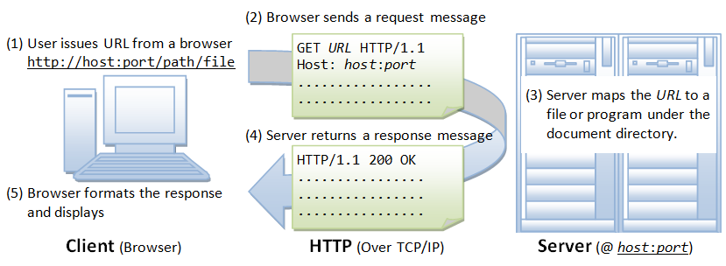
Working Principle of HTTP...
Whenever you issue a URL from your browser to get a web resource using HTTP, e.g. http://www.nowhere123.com/index.html, the browser turns the URL into a request message and sends it to the HTTP server. The HTTP server interprets the request message, and returns you an appropriate response message, which is either the resource you requested or an error message. This process is illustrated below:

Slide 5
URL
It stands for Uniform Resource Locator (URL):
A URL is used to uniquely identify a resource over the web.
An URL has the following syntax:
protocol://hostname:port/path-and-file-name
There are 4 parts in a URL:
Protocol: The application-level protocol used by the client and server, e.g., HTTP, FTP, and telnet.
Hostname: The DNS domain name (e.g., www.nowhere123.com) or IP address (e.g., 192.128.1.2) of the server.
Port: The TCP port number that the server is listening for incoming requests from the clients.
Path-and-file-name: The name and location of the requested resource, under the server document base directory.

Slide 6
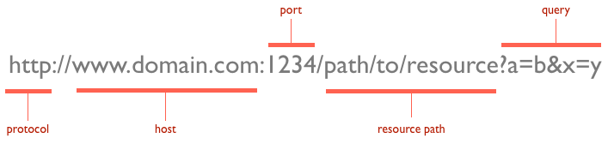
URL...

Slide 7
HTTP Message Format
All Communication takes place via HTTP Messages - Rquest & Response
HPPT is text based.
The message format is
Format | Description
<start-Line> | Conveys the nature of the message
<message-headers> | <header-name>:header-value>
<empty-line> | Separates header & body
[<message-body>] | (Optional) Carries a set of information to be communicated between the client and server.

Slide 8
Request Message Format
The format is
<request-line>
<request-header>
<empty-line>
[<message-body>]

Slide 9
Response Message Format
The format is
<status-line>
<response-headers>
<empty-line>
[<message-body>]

Slide 10
HTTP Methods
These are the commands for the client to prompt the server to take actions.
Always in uppercase.
The most common methods are
Sl. No. | Method Name | Description
1 | GET | Requests that the server retrieves the resource specified in the URL.
2 | HEAD | Similar to GET, but tells the server to not sent the actual body of the message. It is used by the client to check the existence status or size of a file before deciding.
3 | POST | Allows the client to send an entity, containing arbritary data to the server for processing. Ex.It enables a client to send an interactive HTML form to a program on the server.

Slide 11
HTTP Methods..
The other methods are
OPTIONS, PUT, UPDATE, DELETE, TRCE

Slide 12
HTTP Status Codes
HTTP Status line contains both a numeric status code and a text reason phrase.
The general form of HTTP status code is “xyy”, where the first digit x is specified as:

Slide 13
HTTP Status Codes..
The general form of HTTP status code is “xyy”, where the first digit x is specified as:
100 - Continue
200 - OK
404- - Resource invalid (URL)
500 - internal server error.

